Slide 1
PSK and M-ary modulation schemes
Notes:
1

Slide 2
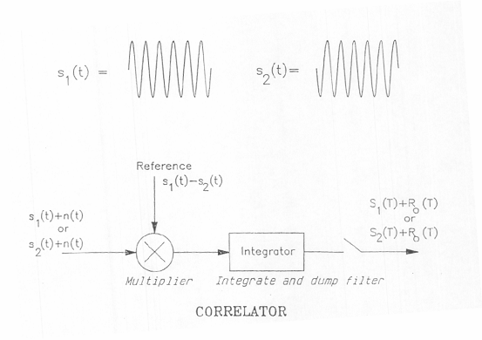
PHASE SHIFT KEYING

Slide 3
PHASE SHIFT KEYING

Slide 4
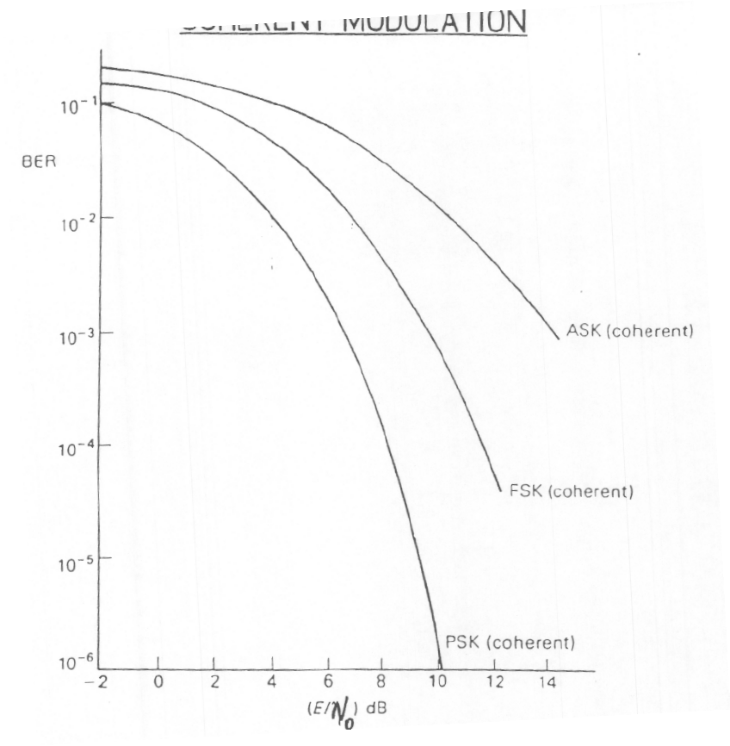
SUMMARY OF BER VERSUS Eb/ No FOR COHERENT MODULATION

Slide 5
M-ARY DATA SYSTEMS
Increased data rate
Many messages in the interval O → T
Techniques
Multi-amplitude eg. 16QAM
Multi-phase eg. QPSK
M-ary systems allow us to conserve power or bandwidth
Eg. QPSK only requires ½ bandwidth of PSK for the same transmission rate and error performance.
However as the number of symbol states is increased the tolerance to noise is reduced. QPSK is an exception.
M-ary QAM is used in many of the current wireless communications systems (example WIFI, 3G LTE and WiMax)

Slide 6
Constellation diagrams

Slide 7
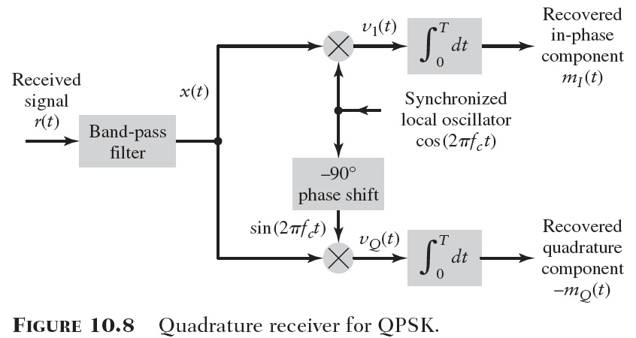
QPSK
It is possible to transmit orthogonal signals at the same transmission link without one set of signals affecting the detection of the other. Cos and Sin waves are orthogonal.
QPSK improves spectral efficiency of BPSK (double)

Slide 8
SYMBOL & BIT ERROR PROBABILTY FOR QPSK

Slide 9
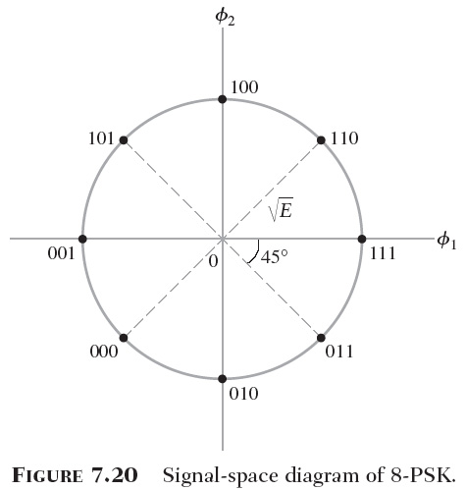
M-ARY PSK – HIGHER ORDER SCHEMES

Slide 10
16 QAM
Can be shown that noise immunity of 16QAM is better than 16PSK for the same signal powers.
Hence Pe(16-QAM) < Pe (16-PSK)

Slide 11
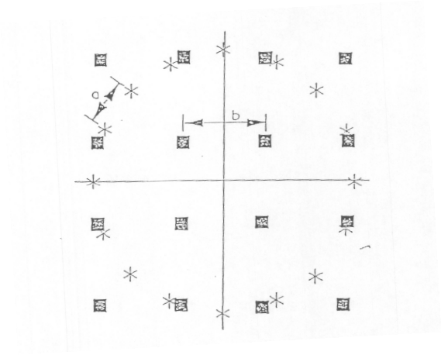
16 QAM , 16PSK comparison
Constellation diagram for 16PSK and 16QAM
Down to scale for equal average symbol power
Spacing between symbol states for QAM is greater than that for PSK
PSK is restricted to having symbol states of equal amplitude (on a circle equidistant from the origin)

Slide 12
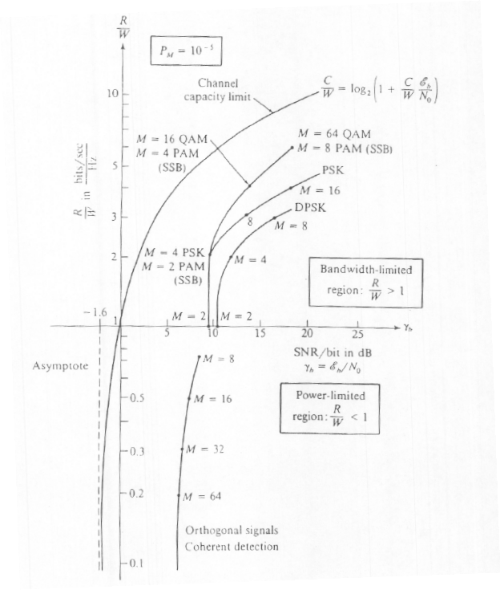
COMPARISON OF MODULATION TECHNIQUES

Slide 13
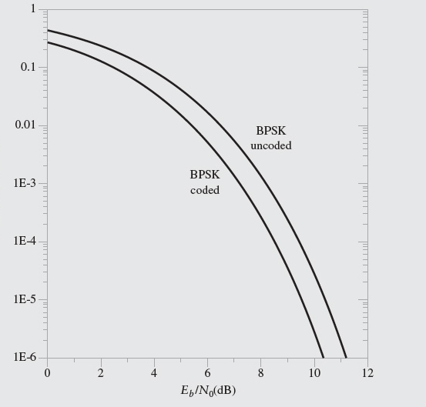
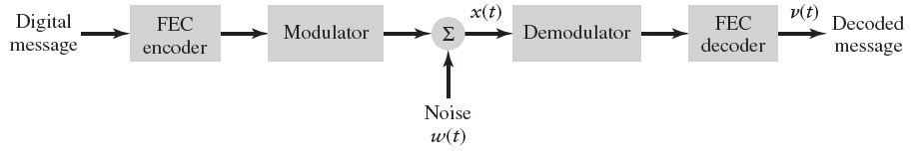
ERROR CONTROL CODING

